Slide 1
How to configure IPv6 and ACL

Slide 2
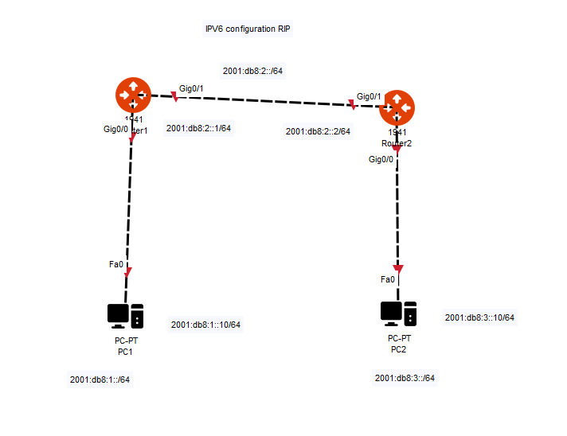

Slide 3
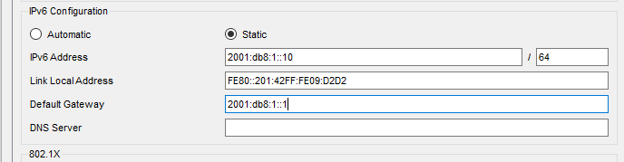
Router>en
Router#config t
Router(config)#ipv6 unicast-routing ( need to type this to enable ipv6 in packet tracer0
Router(config)#int g0/0
Router(config-if)#ipv6 add 2001:db8:1::1/64
Router(config-if)#no shut
Router(config-if)#int g0/1
Router(config-if)#ipv6 add 2001:db8:2::1/64
Router(config-if)#no shut
PC1

Slide 4
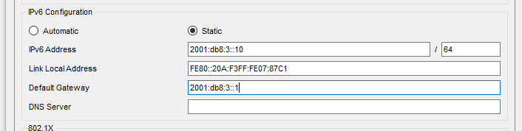
For PC2
Router>en
Router#config t
Router(config)#ipv6 Router(config)#int g0/0
Router(config-if)#ipv6 add 2001:db8:3::1/64
Router(config-if)#no shut
Router(config-if)#int g0/1
Router(config-if)#ipv6 add 2001:db8:2::2/64
Router(config-if)#no shut

Slide 5
When you are configuring ipv6 with a routing protocol you configure the network protocol on the interfaces.
This examples going to use RIPng which is ipv6 version or RIP in ipv6.

Slide 6
R1(config)#int g0/0
R1(config-if)#ipv6 rip cisco enable
R1(config-if)#
R1(config-if)#int g0/1
R1(config-if)#ipv6 rip cisco enable
R1(config-if)#
Router(config-if)#hostname R2
R2(config)#int g0/0
R2(config-if)#ipv6 rip cisco enable
R2(config-if)#int g0/1
R2(config-if)#ipv6 rip cisco enable
R2(config-if)#

Slide 7
R1#show ipv6 route
via GigabitEthernet0/0, directly connected
L 2001:DB8:1::1/128 [0/0]
via GigabitEthernet0/0, receive
C 2001:DB8:2::/64 [0/0]
via GigabitEthernet0/1, directly connected
L 2001:DB8:2::1/128 [0/0]
via GigabitEthernet0/1, receive
R 2001:DB8:3::/64 [120/2]
via FE80::201:C7FF:FE61:6102, GigabitEthernet0/1
L FF00::/8 [0/0]
via Null0, receive
R2#show ipv6 route
R 2001:DB8:1::/64 [120/2]
via FE80::2D0:FFFF:FED6:4702, GigabitEthernet0/1
C 2001:DB8:2::/64 [0/0]
via GigabitEthernet0/1, directly connected
L 2001:DB8:2::2/128 [0/0]
via GigabitEthernet0/1, receive
C 2001:DB8:3::/64 [0/0]
via GigabitEthernet0/0, directly connected
L 2001:DB8:3::1/128 [0/0]
via GigabitEthernet0/0, receive
L FF00::/8 [0/0]
via Null0, receive

Slide 8
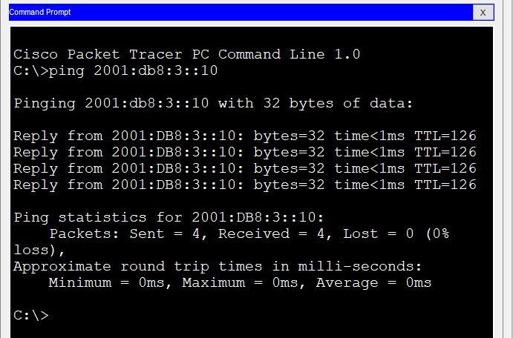
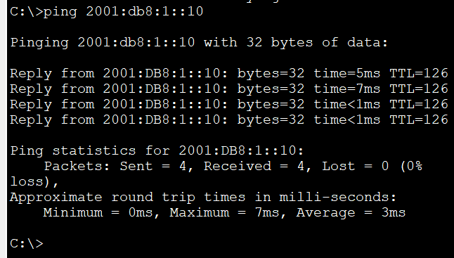
Ping from PC1 to PC2
Pc2 to pc1

Slide 9
When using ipv6 you always type ipv6
Router#show ipv6 route
Please note in order to the ping the machine in ipv6 you have to do it in the command prompt the sending of packet it does not work.

Slide 10
Configure ipv6 eigrp
When you are configure your network with ipv6 for eigrp you apply it to the interfaces.

Slide 11
Router>en
Router#config t
Router(config)#ipv6 unicast-routing ( need to type this to enable ipv6 in packet tracer0
Router(config)#int g0/0
Router(config-if)#ipv6 add 2001:db8:1::1/64
Router(config-if)#no shut
Router(config-if)#int g0/1
Router(config-if)#ipv6 add 2001:db8:2::1/64
Router(config-if)#no shut
PC1

Slide 12
For PC2
Router>en
Router#config t
Router(config)#ipv6 Router(config)#int g0/0
Router(config-if)#ipv6 add 2001:db8:3::1/64
Router(config-if)#no shut
Router(config-if)#int g0/1
Router(config-if)#ipv6 add 2001:db8:2::2/64
Router(config-if)#no shut

Slide 13
R1(config)#int g0/0
R1(config-if)#ipv6 eigrp 10
R1(config-if)#ipv6 router eigrp 10
R1(config-rtr)#eigrp router-id 1.1.1.1
R1(config-rtr)#no shut
R1(config-rtr)#int g0/1
R1(config-if)#ipv6 eigrp 10
R1(config-if)#ipv6 router eigrp 10
R1(config-rtr)#eigrp router-id 1.1.1.1
R1(config-rtr)#no shut
R1(config-rtr)#
R2(config)#int g0/0
R2(config-if)#ipv6 eigrp 10
R2(config-if)#ipv6 router eigrp 10
R2(config-rtr)#eigrp router-id 2.2.2.2
R2(config-rtr)#no shut
R2(config-rtr)#int g0/1
R2(config-if)#ipv6 eigrp 10
R2(config-if)#ipv6 router eigrp 10
R2(config-rtr)#eigrp router-id 2.2.2.2
R2(config-rtr)#no shut
R2(config-rtr)#

Slide 14
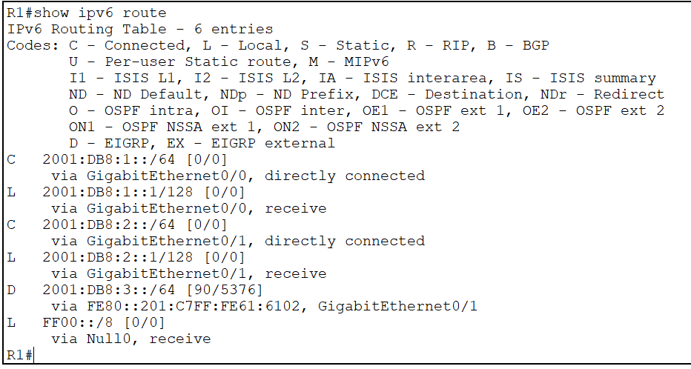
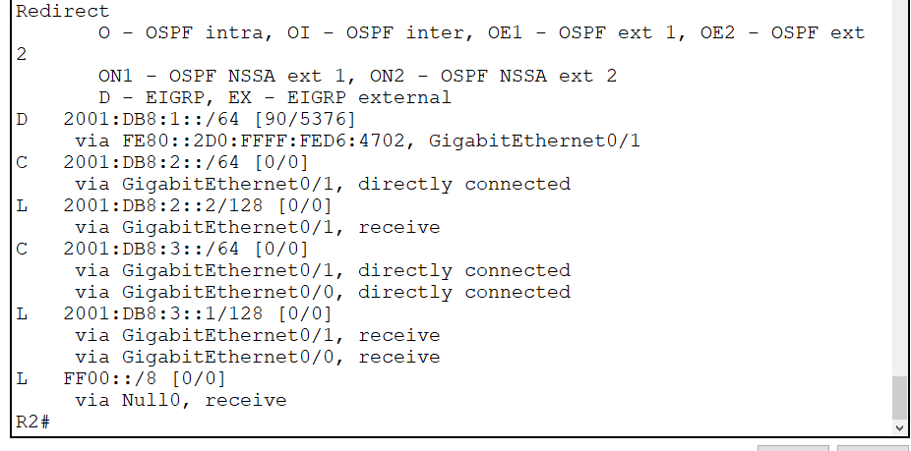

Slide 15
Ospf ivp6
R1(config-if)#int g0/0
R1(config-if)#ipv6 ospf 1 area 0
R1(config-if)#exit
R1(config)#ipv6 router ospf 1
R1(config-rtr)#router-id 2.2.2.2
R1(config-if)#int g0/1
R1(config-if)#ipv6 ospf 1 area 0
R1(config-if)#exit
R1(config)#ipv6 router ospf 1
R1(config-rtr)#router-id 2.2.2.2
R2(config-if)#int g0/0
R2(config-if)#ipv6 ospf 1 area 0
R2(config-if)#exit
R2(config)#ipv6 router ospf 1
R2(config-rtr)#router-id 2.2.2.2
R2(config-if)#int g0/1
R2(config-if)#ipv6 ospf 1 area 0
R2(config-if)#exit
R2(config)#ipv6 router ospf 1
R2(config-rtr)#router-id 2.2.2.2

Slide 16
